Slide 1


Slide 2
Annual Professional Performance Review (APPR)
Evaluation Process for Teachers
Notes:
Slide Summary:
The APPR evaluation process effects both teachers and principals.

Slide 3
Common Core
Data Driven Instruction
APPR
Regents Reform Agenda
Notes:
APPR Common Core State Standards and Data Driven Instruction are the three components of the Regents Reform Agenda designed to improve student achievement and ensure that all students are college and career ready.

Slide 4
APPR
Notes:
Today’s presentation will be on the APPR Evaluation Process for Teachers.

Slide 5
APPR Follows These Design Principles:
Annual evaluations and observations for all, including principals and teachers
Clear, rigorous expectations for instructional excellence, prioritizing student learning
Process: Coaching vs. Evaluative
APPR Framework encourages regular constructive feedback and ongoing development
Notes:
Read slide

Slide 6
APPR is Designed to Measure….
  Teacher effectiveness based on performance, including measures of student achievement and evidence of educator engagement in meeting NYS teaching standards.
Notes:
Read Slide

Slide 7
APPR: Teacher Evaluation Formula
60%
EBOP
20%
Growth
100%
20%
Local
All Teachers
Evidence-based Observations
Notes:
All teachers are required by law to have observations of their practice

Slide 8
60% of Composite Score
  Evaluation Selection Process
    Three Choices
      All 60 pts Administrator observations only
      31pts Administrator observations/up to 29 pts Peer Reviewer observations
      31 pts Administrator observations/up to 29 pts PART
Based on Danielson’s Framework for Teaching
    Professional Practice Rubrics - organized into Domains
    Describes the level of effectiveness required for each rating
Notes:
Some information about the observation process

Slide 9
APPR: Teacher Evaluation Formula
60%
EBOP
20%
Growth
100%
20%
Local
Grades 4-8 ELA Math | All Other Teachers
Student Learning Objectives
Notes:
Student growth will be measured by comparing growth from one grade to the next on the 4-8 ELA and Math exams. NYSED will provide this score.

Slide 10
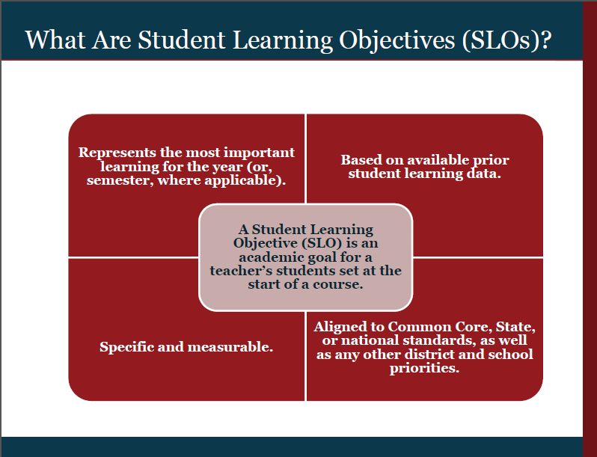
Notes:
This slide lays out New York’s own definition of a Student Learning Objective.
In order to document and focus teacher impact, SLOs must be specific and measureable. Setting goals for student learning emphasizes outcomes, rather than inputs. SLOs focus attention on data and outcomes.
SLOs are long-term, measurable academic goals based on prior student learning data. They are aligned to standards (CCSS, State, or national) and district and school priorities.
2012 – 2013 First Year using SLOs: The Implementation of SLOs, was led by the District.
Content Area Directors (included Lead Teachers) have written the SLOs for the district.

Slide 11
Who MUST have SLOs as
“comparable growth measures”?
Every teacher that does not have 50% or more students taking the 4 – 8 ELA and Math assessments, will need to have a student learning objective (SLO).
Any teacher who does not receive a growth or value added score from the state, will have to be evaluated using a student learning objective (SLO).
Teacher Evaluation Guide: Pg 76

Slide 12
A SLO Must Contain The Following…..
Use State Assessment as evidence if available
(i.e. Grade 3 ELA/Math, Regents Examinations, NYSAA, NYSESLAT, etc.).
Cover the courses taught with the largest number of students, combining sections with common assessments, until majority of students are covered (>50%) .
Use District or BOCES/Locally Developed Assessments as evidence, if no state assessment exists.
** Teachers in Grade 4 – 8 ELA and Math, DO NOT need a SLO
Notes:
Rule:
Assess all of your students within the same subject and grade level….
Ex: ----Common Branch Teacher: Need 1 SLO for Math and 1 for ELA - - covers every student in class.
The >50% Rule: ONLY comes into play when a Teacher teaches Multiple Subjects
Start with your largest group in the same grade and subject level- - - That will be your SLO…..

Slide 13
Pre & Post Assessment
Window for SLOs
Assessments for Local Measure:
October 1 – 30, 2012
May 20 - 31, 2013
* Measures of Academic Progress (MAP)
Notes:
Achievement Score: Is an Achievement Score? And it will be measured by……
Teachers will administer the Pre-Test, Correct them and send in their Class Roster indicating their Baseline Scores.
There will be a webinar to train you how to complete this, which includes filling out your Student Population.
Post Tests……Teachers will not administer Post Tests…..Stay Tuned for Guidance from Administrator

Slide 14
APPR: Teacher Evaluation Formula
60%
EBOP
20%
Growth
100%
20%
Local
All Teachers
Measures of Achievement
Notes:
For the final 20%, all teachers will receive a score from the district based on a measure of student achievement.
Where we are using locally developed assessments or percentile scores (if AIMSWEBB or NWEA are used for the local subcomponent) for the local measures subcomponent, only the final test (i.e. Post Assessment) will be used to determine the score.

Slide 15
A Final Evaluation Composite Score is based on all of the components and will be calculated and one of the following ratings will be used: “HEDI”
Notes:
Read slide HEDI pronounced Heidi

Slide 16
APPR: Rating Categories
Highly Effective
Effective
Developing
Ineffective
Notes:
The four rating categories were set by the state along with the cutpoints for each level.

Slide 17
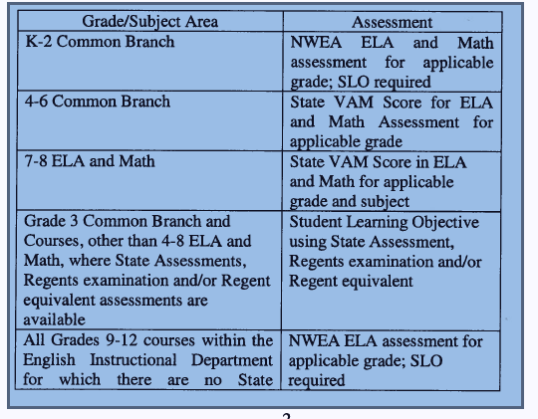
FAQ: What assessments will be used for State Growth for teachers for the 2012 2013 school year?
Assessments for State Growth Component:
Exception of Grade 3 & Eng III:
Pre: BOCES/Locally Developed
Post: State / Regents Exam
All other subject areas and CTE courses - - - BOCES/Locally developed assessment
Science 7: Pre / Post: NWEA
Science 8: Pre BOCES/ Locally developed assessment
/ Post State Exam
* Measures of Academic Progress (MAP)
Notes:
What will be the format of the Assessments?
Pre and Post: BOCES/Locally Developed Assessments
Pencil and Paper using the Scranton Sheets
Follow the same protocol as our regular Testing Env - - JSchultz will be working with her Test Liaisons in the building….To communicate the process.
NWEA is all Electronic Testing……
NWEA is certainly used in the SLO assessments
However, if your building is using NWEA for screening - - please continue with your School Building’s Protocol

Slide 18
FAQ: What assessments will be used for Local Measure for teachers for the 2012 2013 school year?
Assessments for Local Measure:
Grade/Subject Area | Assessment
K-2 Common Branch | AIMSWEB
3-6 Common Branch | NWEA MAP ELA/Math
7-8 ELA and Math | NWEA MAP ELA/Math
7 Science | BOCES Post-assessment
8 Science | NWEA MAP Science
9 – 12 ELA Courses | NWEA MAP ELA, with the exception of Eng III
All other grades and subjects | Regents or BOCES/Locally developed assessments
Achievement Score
* Measures of Academic Progress (MAP)

Slide 19
FAQ: What’s the minimum number Observations for 2012 2013 school year?
Assessments for Local Measure:
Tenured Teachers | 1 Formal Observation (includes Pre and Post Conferences) | 1 Unannounced Informal Observation
Non-Tenured Teachers | 2 Formal Observations (includes Pre and Post Conferences) | 1 Unannounced Informal Observation
*Minimum Required
Multiple Observations and Informal Walkthroughs
Notes:
Emphasize: * Minimum Required
Multiple Observations and Informal Walkthroughs

Slide 20
FAQ: Instructional Support Staff
Assessments for Local Measure:
Example: Who is NOT covered under the New Evaluation System?
TCOSE
ISS / ATS
Teacher on Assignment
Speech Teachers (if they do not have a CR)
ELA / Math / Data Coaches
Registrars
Notes:
Reiterate: If the staff member is NOT the Teacher of Record (TOR), then they are NOT Evaluated under APPR - - they will be evaluated under the Traditional System….However, the teacher CAN elect to use the Danielson Rubric if they choose too.

Slide 21
FAQ: Instructional Support Staff
Assessments for Local Measure:
FAQ: Instructional Support Staff
2012-2013 specialized rubrics are in the ePerformance system
Not evaluated under APPR
Counselors
Psychologists
Social Workers
Lead Teachers (District-Level)
Notes:
Reiterate: If the staff member is NOT the Teacher of Record (TOR), then they are NOT Evaluated under APPR - - they will be evaluated under the Traditional System….However, the teacher CAN elect to use the Danielson Rubric if they choose too.

Slide 22
Summary
Teachers Evaluation Process
Teachers under APPR: Goal Setting
Teachers with Approved Specialized Rubrics:
Goal Setting - - - NOT under APPR
Everybody Else: Traditional Rubric
            Professional Development Incentive (PDI) - Goal Setting for PDI
            Elect to use the Danielson Rubric
Notes:
For the Traditional Teachers - - Goal Setting will NOT be a part of their evaluation system…..
There is a place in ePerformance System for them to add goals, but it is not a part of the Traditional Rubric

Slide 23
Helpful Resources
http://www.rcsdk12.org
Departments
EngageRochester
APPR
http://engageny.org/
www.nysed.gov
Teacher Evaluation Guide 2012-2013
APPR Approved Plan (i.e. District’s Website)
FAQs: Under Resources Link on EngageRochester
APPR Questions:
      Performance_eval@rcsdk12.org
Notes:
For additional information on APPR you can visit the engageRochester website by following these directions
Also, engageny.org is a great resource for more in-depth information about APPR
Or you can reference documents regarding Race To The Top on the NY State Ed website.

